Slide 1

SEMINAR 2
NLP MODEL
TO ANALYZE
INTERVIEWEE’S ANSWER- RELeVaNTNESS TO THE QUESTION ASKED
PRESENTED BY
AMBAR BRAHMACHARI

Slide 2


Objective……..
Make an NLP model to analyze the transcript to analyze the answer- relevantness of the interviewee to the question asked.
Methods Used……..
1. Using a Pre-trained model from Hugging Face and then fine-tuning it.
2. Using GPT4all and Open AI to make a model with Prompt Engineering.

Slide 3
METHOD 1

Slide 4
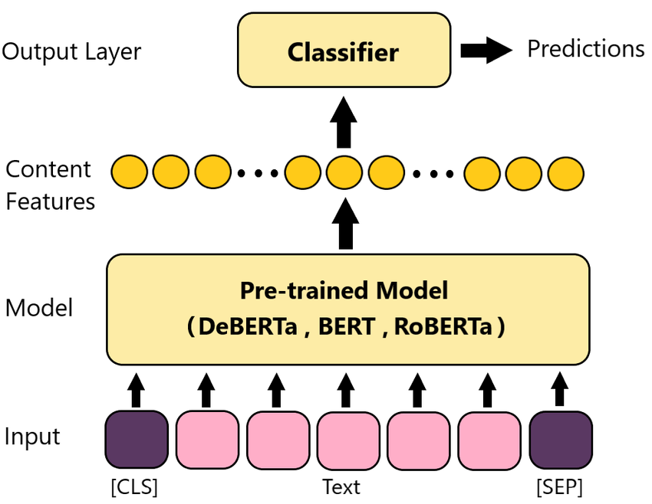
KEY USE CASES OF HUGGING FACE
These models are trained on large-scale datasets and provide high-quality representations of text.
PRE-TRAINED MODELS
BERT, GPT, RoBERTa are pre-trained models based on transformer architectures
Serves as a centralized repository for accessing and exploring these models.

Slide 5
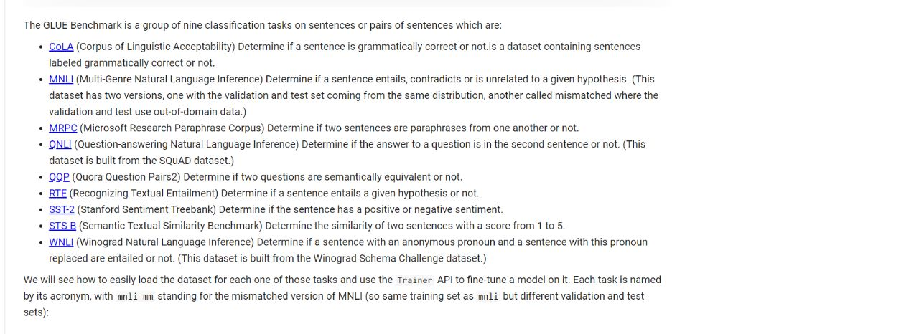
FINE-TUNING & TRANSFER LEARNING
Facilitates the process of fine-tuning pre-trained models on specific downstream tasks
Involves training the pre-trained model on task-specific data to adapt it to the target task.

Slide 6
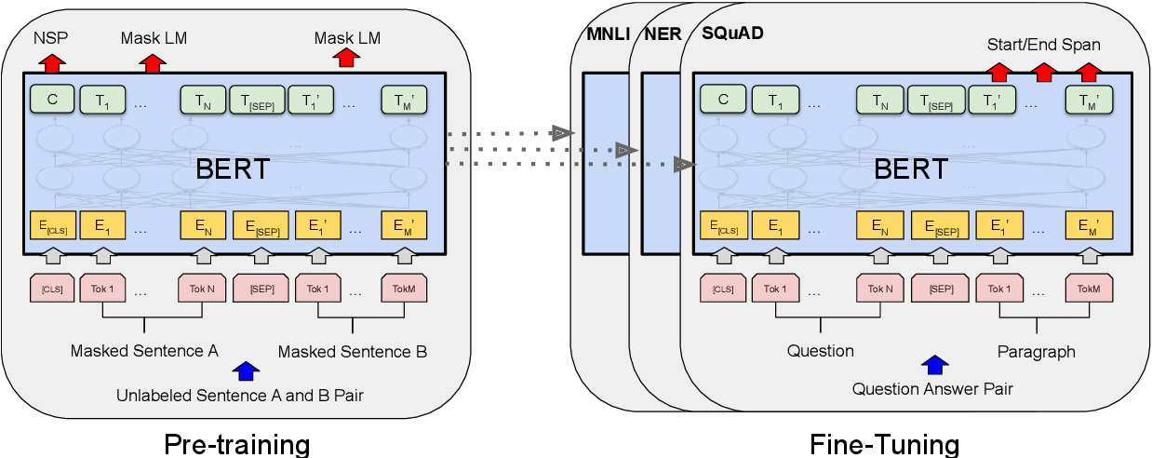
Provides utilities and examples for fine-tuning models, making it easier to apply transfer learning and achieve state-of-the-art results
The paper "BERT: Pre-training of Deep Bidirectional Transformers for Language Understanding" by Devlin et al. (2018) introduces the BERT model and discusses the benefits of fine-tuning.

Slide 7
METHOD 2

Slide 8
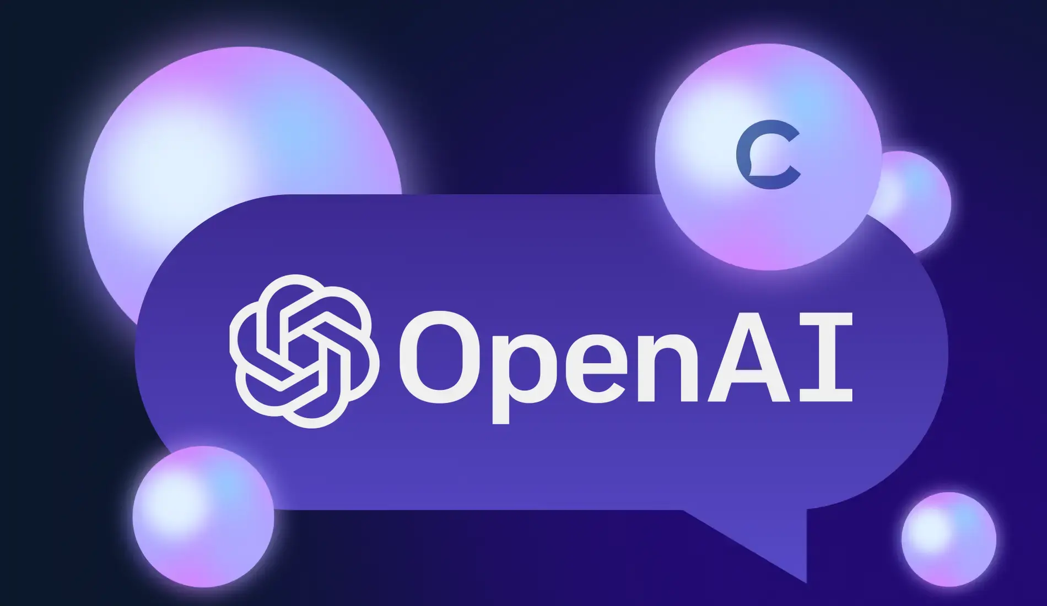
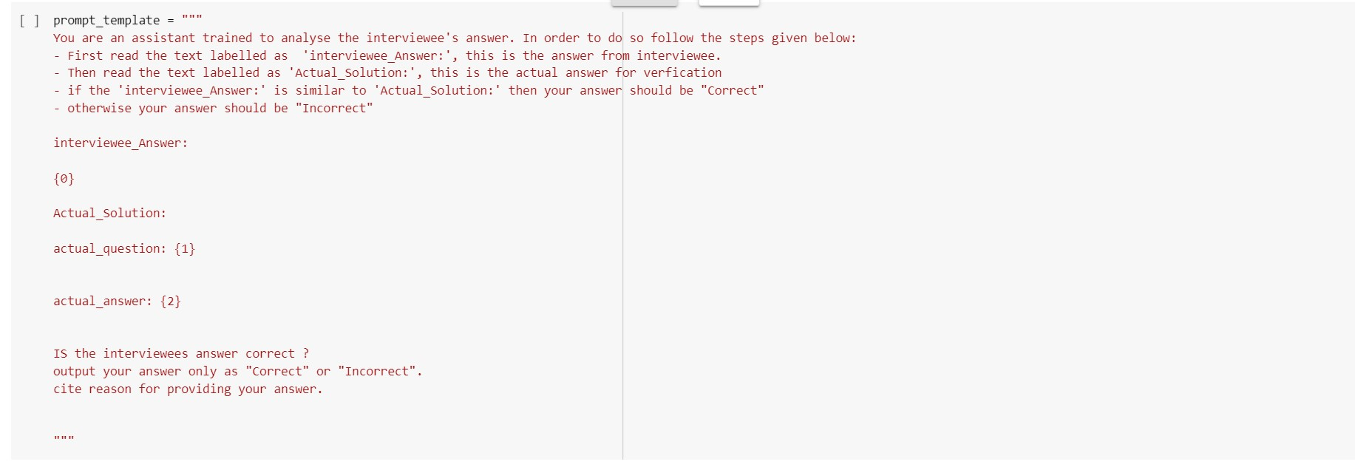
MODEL
PROMPT ENGINEERING
Involves designing and refining prompts or instructions to guide the model's text generation
Careful crafting of the input text or question can elicit specific responses or control the behavior of the model.
It is an essential technique to achieve desired outputs from OpenAI models
To optimize the model's responses, we can experiment with different prompt variations, question phrasing, and context setting

Slide 9
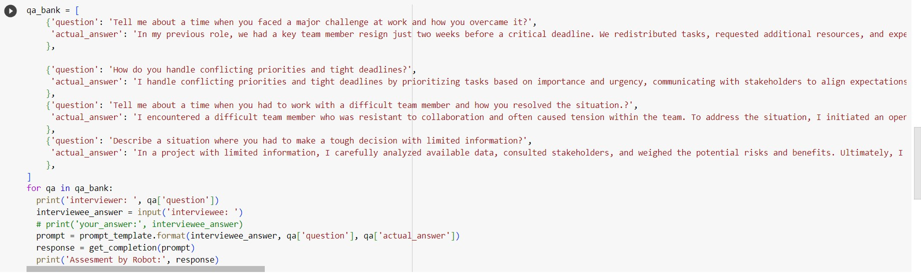
MODEL
DATA SET
CODE

Slide 10


